Slide 1

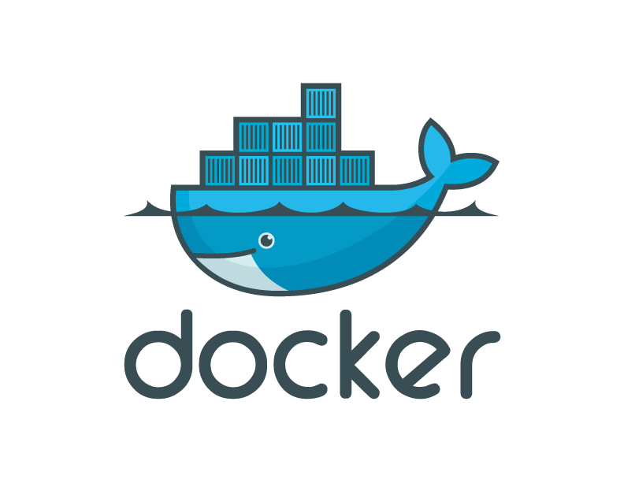
Introduction to Docker Containers

Slide 2


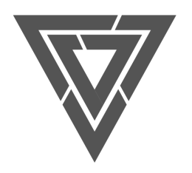
Contents
The challenge
The Solution
What is Docker and Why people care: Separation of Concerns
How They Work?
Containers vs. VMs
Docker Components
Docker Architecture
Use Cases
Ecosystem

Slide 3

What Is the Problem?

Slide 4
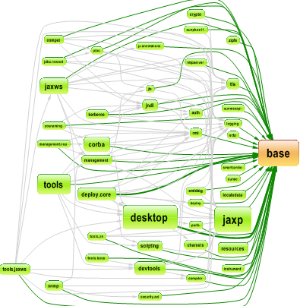
The dependency hell
pip : Python
Gem: Ruby
npm: Node.js
Composer: PHP

Slide 5
Challenges
2015
Thin app on mobile, tablet
Assembled by developers using best available services
How to ensure services interact consistently, avoid dependency hell
How to avoid n X n different configs
Running on any available set of physical resources
(public/private/
virtualized)
How to migrate & scale quickly, ensure compatibility

Slide 6

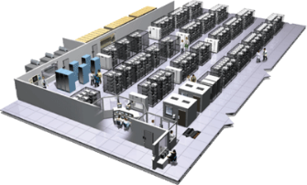
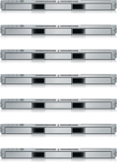
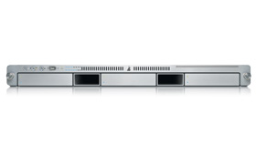
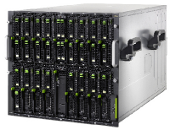
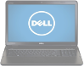
The Challenge
User DB
Static website
postgresql + pgv8 + v8
Queue
Analytics DB
nginx 1.5 + modsecurity + openssl + bootstrap 2
Do services and apps interact appropriately?
Redis + redis-sentinel
hadoop + hive + thrift + OpenJDK
Multiplicity of Stacks
Background workers
Web frontend
Python 3.0 + celery + pyredis + libcurl + ffmpeg + libopencv + nodejs + phantomjs
Ruby + Rails + sass + Unicorn
API endpoint
Python 2.7 + Flask + pyredis + celery + psycopg + postgresql-client
Production Cluster
Development VM
Public Cloud
Multiplicity of hardware environments
QA server
Can I migrate smoothly and quickly?
Disaster recovery
Customer Data Center
Contributor’s laptop
Production Servers

Slide 7
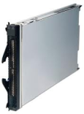
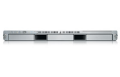
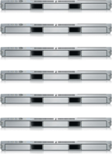

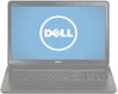
The Matrix From Hell
? | ? | ? | ? | ? | ? | ?
? | ? | ? | ? | ? | ? | ?
? | ? | ? | ? | ? | ? | ?
? | ? | ? | ? | ? | ? | ?
? | ? | ? | ? | ? | ? | ?
? | ? | ? | ? | ? | ? | ?
Static website
Web frontend
Background workers
User DB
Analytics DB
Queue
 | Development VM | QA Server | Single Prod Server | Onsite Cluster | Public Cloud | Contributor’s laptop | Customer Servers

Slide 8
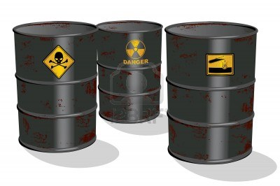
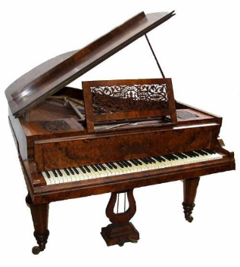

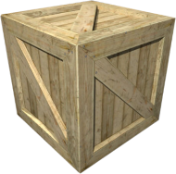
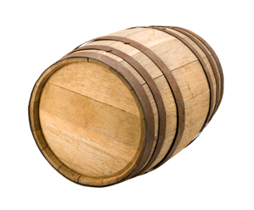
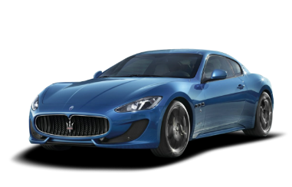
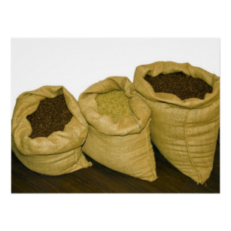

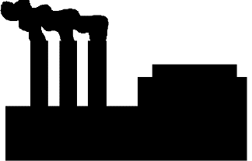

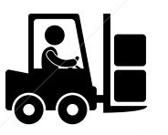
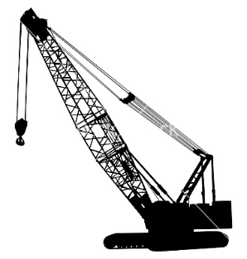
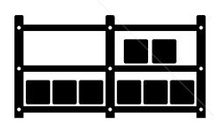

Cargo Transport Pre-1960
Do I worry about how goods interact (e.g. coffee beans next to spices)
Multiplicity of Goods
Multipilicity of methods for transporting/storing
Can I transport quickly and smoothly
(e.g. from boat to train to truck)

Slide 9
The Solution

Slide 10
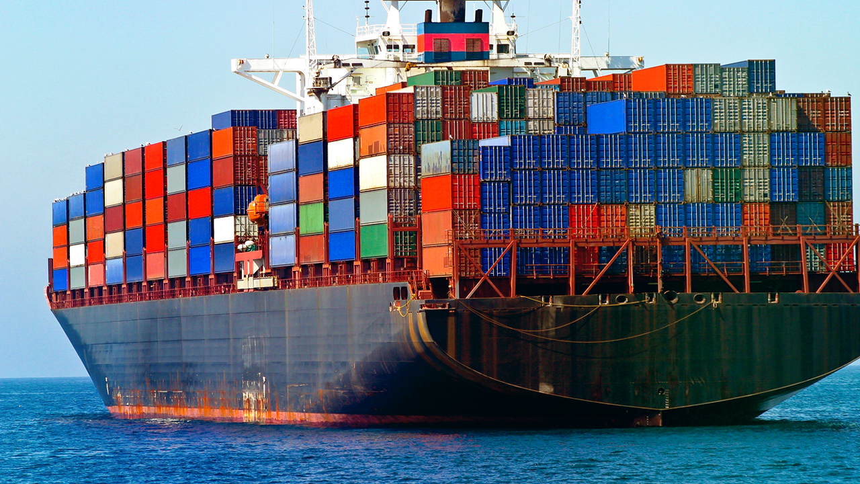
The Solution

Slide 11
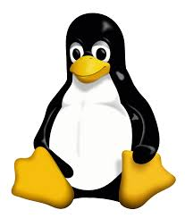
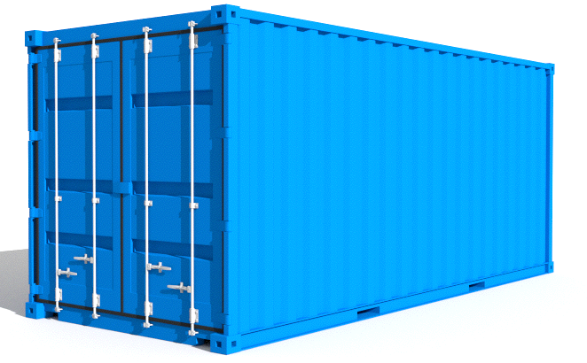
Linux Containers
An operating system–level virtualization method for running multiple isolated Linux systems (containers) on a single control host.

Slide 12

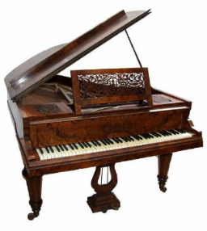

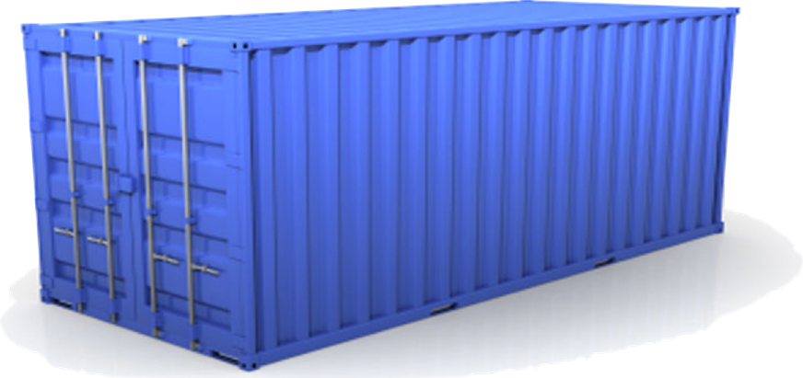
Solution: Intermodal Shipping Container
Do I worry about how goods interact (e.g. coffee beans next to spices)
Multiplicity of Goods
A standard container that is loaded with virtually any goods, and stays sealed until it reaches final delivery.
…in between, can be loaded and unloaded, stacked, transported efficiently over long distances, and transferred from one mode of transport to another
Can I transport quickly and smoothly
(e.g. from boat to train to truck)
Multiplicity of methods for transporting/storing

Slide 13
Docker is a shipping container system for code
Static website
User DB
Web frontend
Queue
Analytics DB
Do services and apps interact appropriately?
Multiplicity of Stacks
An engine that enables any payload to be encapsulated as a lightweight, portable, self-sufficient container…
…that can be manipulated using standard operations and run consistently on virtually any hardware platform
Multiplicity of hardware environments
Can I migrate smoothly and quickly
Development VM
QA server
Customer Data Center
Public Cloud
Production Cluster
Contributor’s laptop

Slide 14
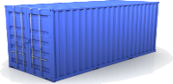
Docker eliminates the matrix from Hell
Static website
Web frontend
Background workers
User DB
Analytics DB
Queue
 | Development VM | QA Server | Single Prod Server | Onsite Cluster | Public Cloud | Contributor’s laptop | Customer Servers

Slide 15
VMs vs. Containers

Slide 16

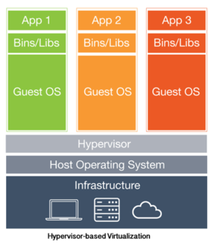
VMs
Notes:
Houses (the VMs) are fully self-contained and offer protection from unwanted guests. They also each possess their own infrastructure – plumbing, heating, electrical, etc. Furthermore, in the vast majority of cases houses are all going to have at a minimum a bedroom, living area, bathroom, and kitchen. It’s incredibly difficult to ever find a “studio house” – even if one buys the smallest house they can find, they may end up buying more than they need because that’s just how houses are built.
VMs are a full copy of an operating system with it’s own dedicated resources. If you decide you need a new house, you build a whole new house – it’s own foundation, plumbing etc. if you want a new VM you deploy a full copy of that environment – the OS, the apps, everything. VMs stand alone, and the leads to duplicating resources – every instance has it’s own full copy of the OS, for instance. Finally the smallest VMs are typically at least hundreds of MBs in size, and they take several minutes to boot up (partially due to the fact that you’re starting a full copy of the OS).
Apartments (Docker containers) also offer protection from unwanted guests, but they are built around shared infrastructure. The apartment building (the server running the Docker daemon, otherwise known as a Docker host) offers shared plumbing, heating, electrical, etc. to each apartment. Additionally apartments are offered in several different sizes – from studio to multi-bedroom penthouse. You’re only renting exactly what you need.
Docker containers share the underlying resources of the Docker host. Furthermore, developers build a Docker image that includes exactly what they need to run their application: starting with the basics and adding in only what is needed by the application. Containers are very small (some base OS images are less than 3MBs) start up very quickly (< 3/8s of a second) because you’re not booting a full operating system. You’re just starting a process.

Slide 17
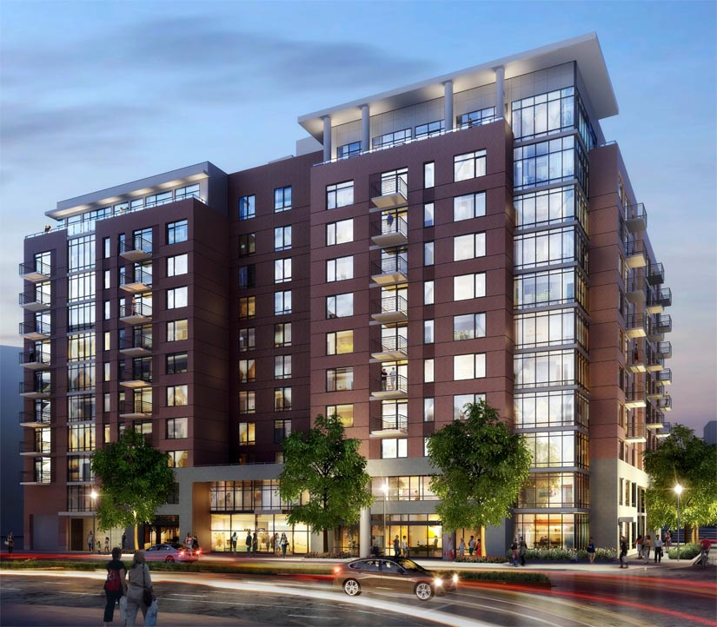
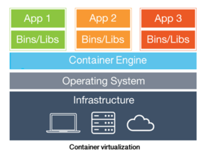
Containers
Notes:
So if containers are not VMs, a logical question is: Can VMs and Docker containers coexist?
The answer is a resounding “yes.”
At the most basic level VMs (in all their forms) are a great place for Docker hosts to run. Whether it’s a vSphere VM or a Hyper-V VM or an AWS EC2 instance, all of them will serve equally well as a Docker host. Depending on what you need to do, a VM might be the best place to land those containers. But the great thing about Docker is that, it doesn’t matter where you run containers – and it’s totally up to you.
Another question that is often asked relates to whether or not Docker container-based services can interact with VM-based services. Again, the answer is absolutely yes. Running your application in a set of Docker containers doesn’t preclude it from talking to the services running in a VM.
For instance, your application may need to interact with a database that resides in a virtual machine. Provided that the right networking is in place, your app can interact with that database seamlessly.
Another area where there can be synergy between VMs and Docker containers is in the area of capacity optimization. VMs gained early popularity because the enabled higher levels of server utilization. That’s still true today. A virtualization host, for instance, can host VMs that may house Docker hosts, but may also host any number of traditional monolithic VMs. By mixing and matching Docker hosts with “traditional” VMs, sysadmins can be assured they are getting the maximum utilization out of their physical hardware.
One of the most powerful things about Docker is the flexibility it affords IT organizations. The decision of where to run your applications can be based 100% on what’s right for your business. You’re not locked into any single infrastructure, you can pick and choose and mix and match in whatever manner makes sense for you organization. Docker hosts on vSphere? Great. Azure? Sure. Physical servers? Absolutely. With Docker containers you get a this great combination of agility, portability, and control.
Containers are isolated, but share OS and, where appropriate, bins/libraries
…result is significantly faster deployment, much less overhead, easier migration, faster restart

Slide 18
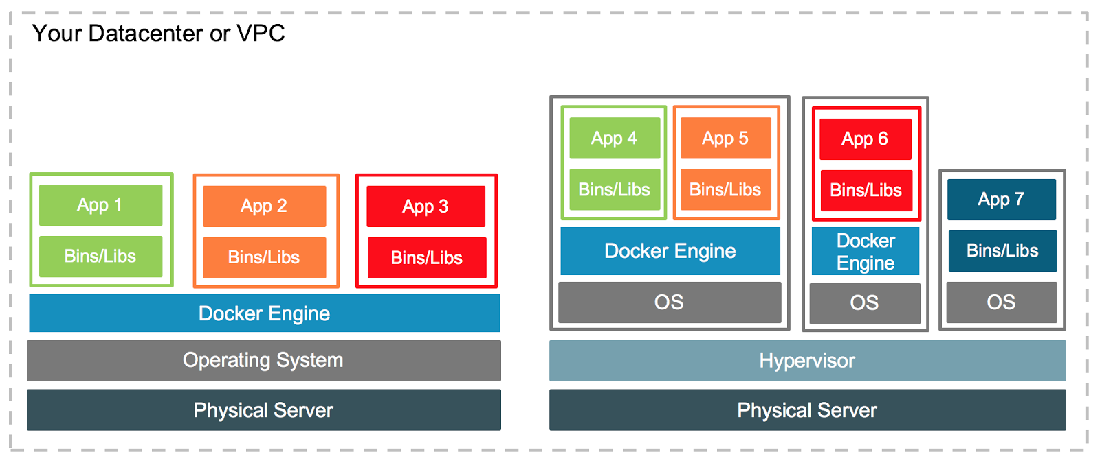
They’re different, not mutually exclusive
Notes:
So if containers are not VMs, a logical question is: Can VMs and Docker containers coexist?
The answer is a resounding “yes.”
At the most basic level VMs (in all their forms) are a great place for Docker hosts to run. Whether it’s a vSphere VM or a Hyper-V VM or an AWS EC2 instance, all of them will serve equally well as a Docker host. Depending on what you need to do, a VM might be the best place to land those containers. But the great thing about Docker is that, it doesn’t matter where you run containers – and it’s totally up to you.
Another question that is often asked relates to whether or not Docker container-based services can interact with VM-based services. Again, the answer is absolutely yes. Running your application in a set of Docker containers doesn’t preclude it from talking to the services running in a VM.
For instance, your application may need to interact with a database that resides in a virtual machine. Provided that the right networking is in place, your app can interact with that database seamlessly.
Another area where there can be synergy between VMs and Docker containers is in the area of capacity optimization. VMs gained early popularity because the enabled higher levels of server utilization. That’s still true today. A virtualization host, for instance, can host VMs that may house Docker hosts, but may also host any number of traditional monolithic VMs. By mixing and matching Docker hosts with “traditional” VMs, sysadmins can be assured they are getting the maximum utilization out of their physical hardware.
One of the most powerful things about Docker is the flexibility it affords IT organizations. The decision of where to run your applications can be based 100% on what’s right for your business. You’re not locked into any single infrastructure, you can pick and choose and mix and match in whatever manner makes sense for you organization. Docker hosts on vSphere? Great. Azure? Sure. Physical servers? Absolutely. With Docker containers you get a this great combination of agility, portability, and control.
Containers are isolated, but share OS and, where appropriate, bins/libraries
…result is significantly faster deployment, much less overhead, easier migration, faster restart

Slide 19
What is Docker and Why people care

Slide 20

What is Docker?
Docker is “a platform for developers and sysadmins to develop, ship, and run applications”, based on containers.
Docker is open-source, mainly created in Go and originally on top of libvirt and LXC.
Docker simplifies and standardizes the creation and management of containers.

Slide 21
Why Docker?
Ship More Software Faster.
Minimal overhead/resource usage.
Run thousands of containers.
Easy to run your whole production stack locally.
Simply share your application with others.
Faster delivery of your applications.
Deploying and scaling more easily.
Fully Automated, Easy To Deploy, Quickly Scale.
Run more apps on one host machine.
Application portability.

Slide 22

Time to Provision:
Bare metal: 8 to 24 Hours
Cloud VM: 5 to 10 Minutes
Container: 5 to 15 Seconds

Slide 23
Why Developers Care
Build once…(finally) run anywhere*
A clean, safe, hygienic and portable runtime environment for your app.
No worries about missing dependencies, packages and other pain points during subsequent deployments.
Run each app in its own isolated container, so you can run various versions of libraries and other dependencies for each app without worrying.
Automate testing, integration, packaging…anything you can script.
Reduce/eliminate concerns about compatibility on different platforms, either your own or your customers.
Cheap, zero-penalty containers to deploy services? A VM without the overhead of a VM? Instant replay and reset of image snapshots? That’s the power of Docker.
* With the 0.7 release, we support any x86 server running a modern Linux kernel (3.2+ generally. 2.6.32+ for RHEL 6.5+, Fedora, & related)

Slide 24
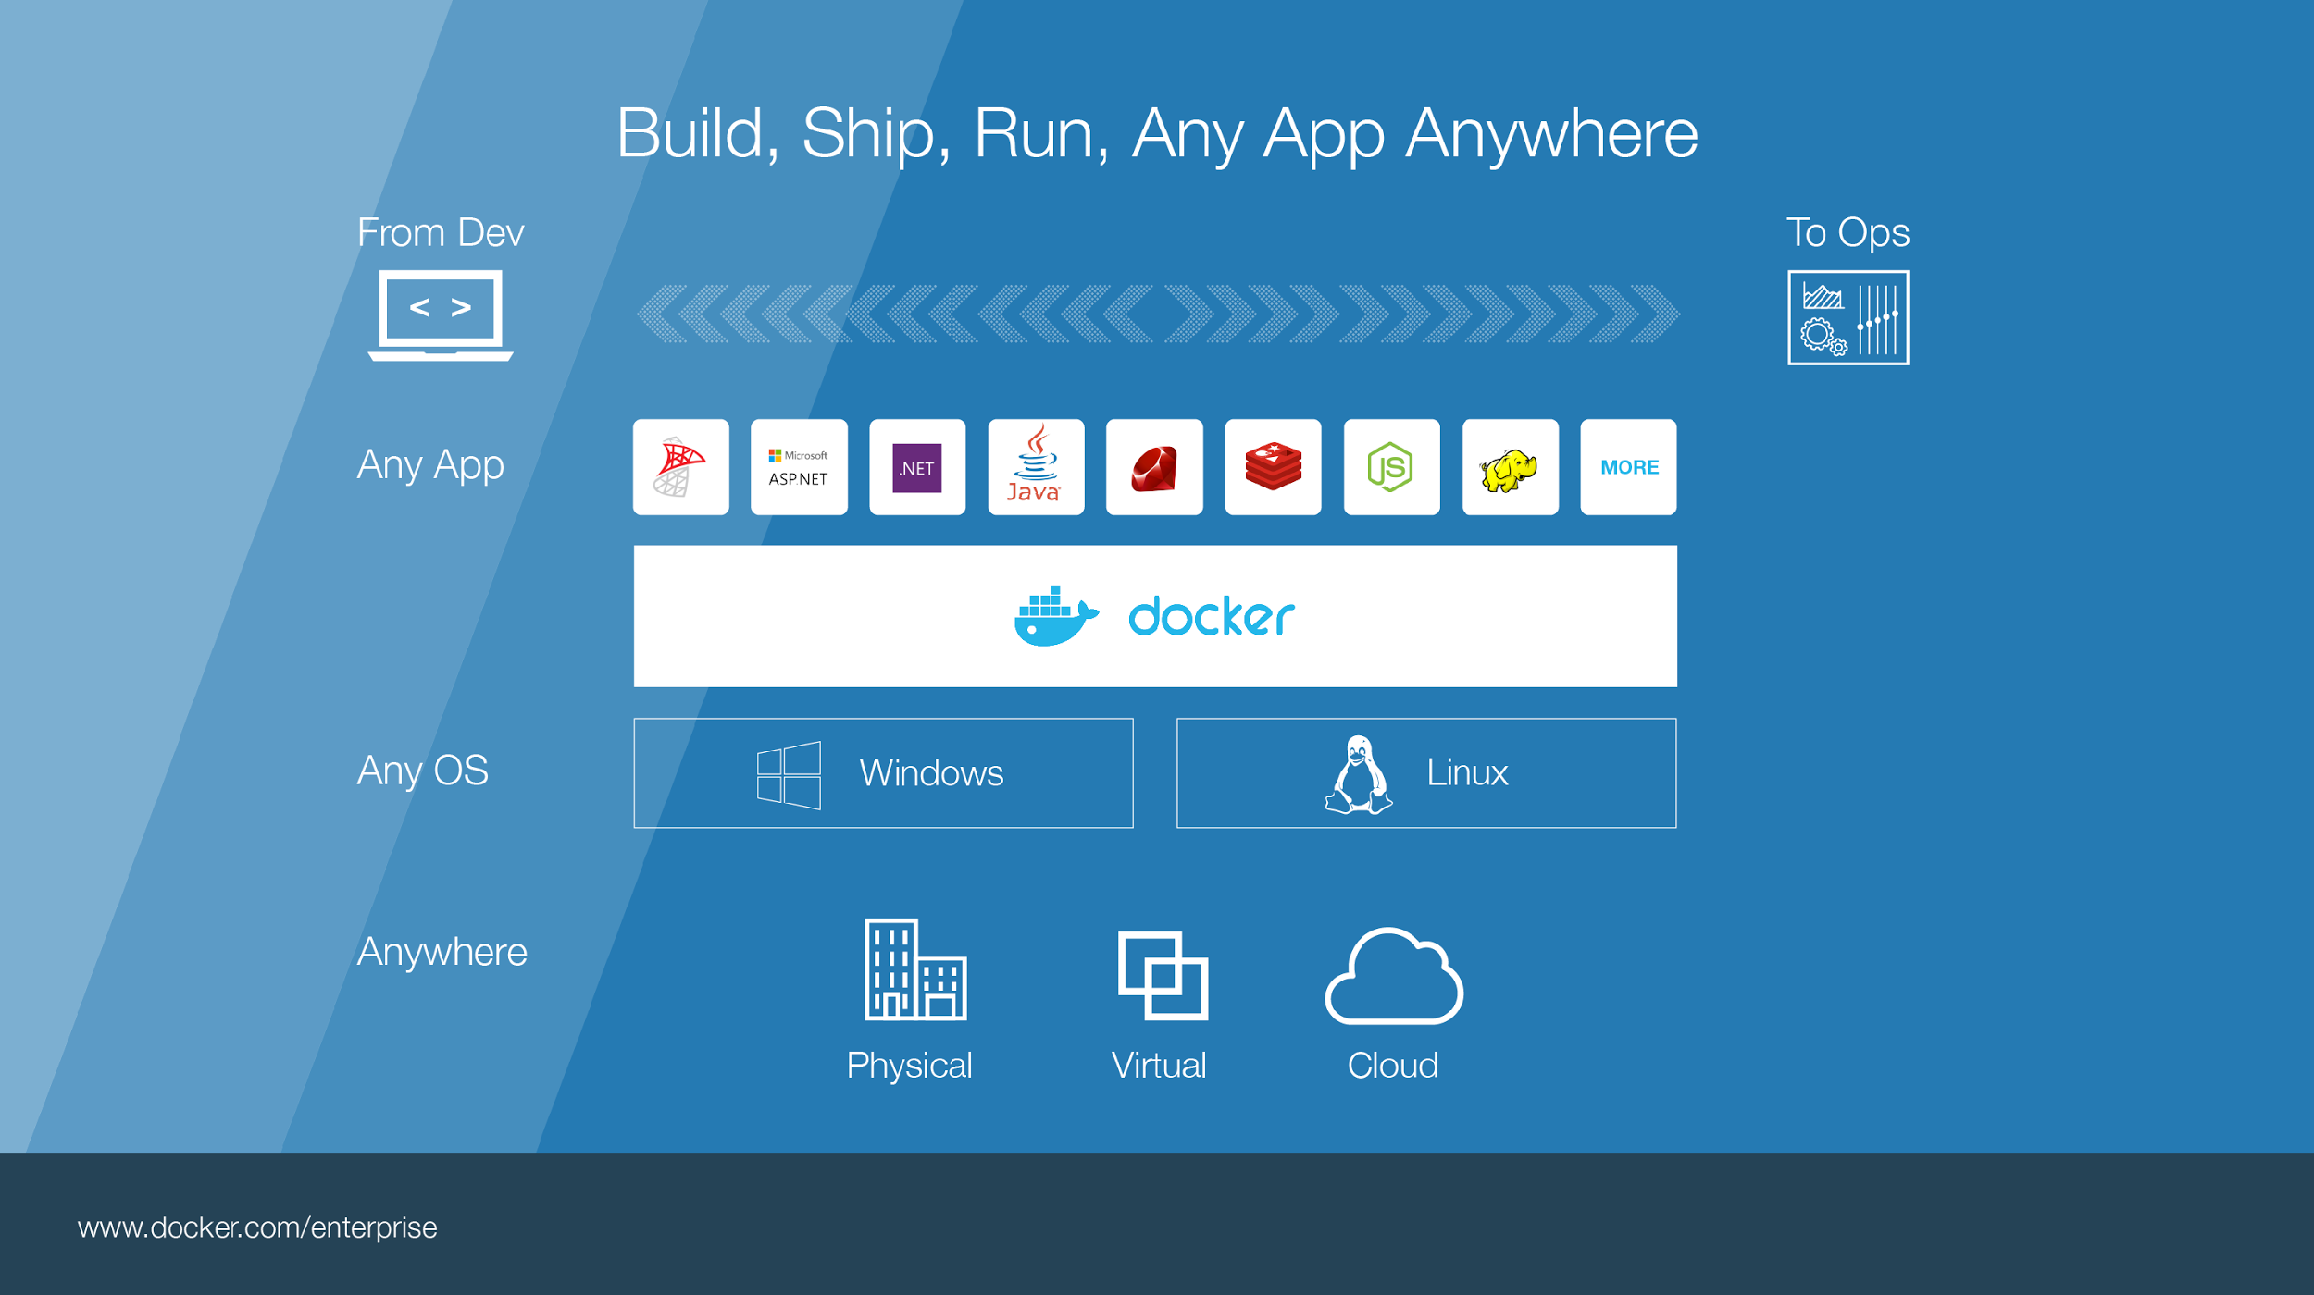
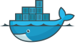
Notes:
Build, Ship, Run – Any App Anywhere – that’s Docker’s slogan
But, what does it mean?
What it essentially boils down to is that developers can choose whatever language or components they want to build their application – .Net, ASP, Java, Ruby, Redis, etc across both the Linux and Windows ecosystem. They are assured that whatever the code up, will run wherever the Ops team chooses to deploy it – Physical, virtual, or cloud – it makes no difference to Docker.
An application written on a developers laptop will run exactly the same on the largest bare metal servers, in the cloud, even on a Raspberry Pi in my den.
Move applications seamlessly from dev to test to production.

Slide 25
Why Devops Cares?
Configure once…run anything
Make the entire lifecycle more efficient, consistent, and repeatable
Increase the quality of code produced by developers.
Eliminate inconsistencies between development, test, production, and customer environments
Support segregation of duties
Significantly improves the speed and reliability of continuous deployment and continuous integration systems
Because the containers are so lightweight, address significant performance, costs, deployment, and portability issues normally associated with VMs

Slide 26
How They Work?

Slide 27
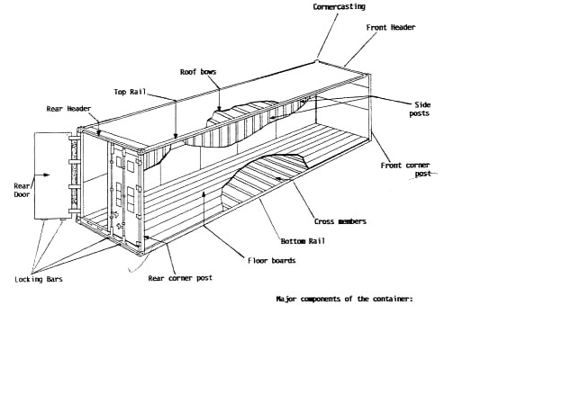
Why it works - separation of concerns
Dan the Developer
Worries about what’s “inside” the container
His code
His Libraries
His Package Manager
His Apps
His Data
All Linux servers look the same
Oscar the Ops Guy
Worries about what’s “outside” the container
Logging
Remote access
Monitoring
Network config
All containers start, stop, copy, attach, migrate, etc. the same way

Slide 28
More technical explanation
WHY
WHAT
Run everywhere
Regardless of kernel version (2.6.32+)
Regardless of host distro
Physical or virtual, cloud or not
Container and host architecture must match*
Run anything
If it can run on the host, it can run in the container
i.e. if it can run on a Linux kernel, it can run
High Level—It’s a lightweight VM
Own process space
Own network interface
Can run stuff as root
Can have its own /sbin/init (different from host)
<<machine container>>
Low Level—It’s chroot on steroids
Can also not have its own /sbin/init
Container=isolated processes
Share kernel with host
No device emulation (neither HVM nor PV) from host)
<<application container>>

Slide 29
Docker Components

Slide 30




Docker components
Docker Image
The basis of a Docker container. Represents a full application
Docker Container
The standard unit in which the application service resides and executes
Docker Engine
Creates, ships and runs Docker containers deployable on a physical or virtual, host locally, in a datacenter or cloud service provider
Registry Service (Docker Hub or Docker Trusted Registry)
Cloud or server based storage and distribution service for your images
Notes:
Let’s take a look at what build, ship run means in a little more detail, but before that we need to level set some Docker vocabulary and commands:
Image
The static component that represents a on-running applicatoin
Containers are derived from images
images contain EVERYTHING an application needs to run
Should always be built via a Dockerfile (which we’ll talk about in a bit_
Container
The standard unit in which the application service resides
Package app and dependencies together
Isolated from other containers
One container per app / service
Docker Engine
The program that creates, ships and runs containers
Deployable on any physical or vm host locally, in datacenters or cloud
Communicates with Docker Hub
Registry
The service that store, distributes and manages container images
Receives commands from Docker Client via Engine
Access control with public, private repos

Slide 31
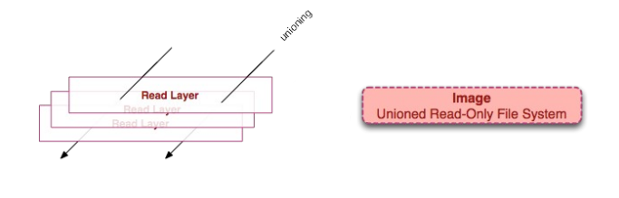
Images
Read only template used to create containers
Build by you or other docker users
Stored in the docker hub or you local registry
Every image starts from base image

Slide 32
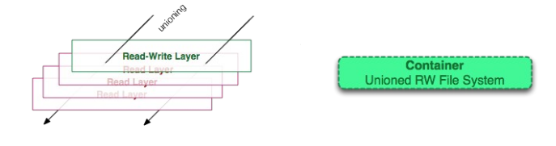
Containers
Isolated application platform
Containers everything needed to run you application
Based on one or more images
Docker containers launched from Docker image
When Docker container runs, it adds a read-write layer on top of the image

Slide 33
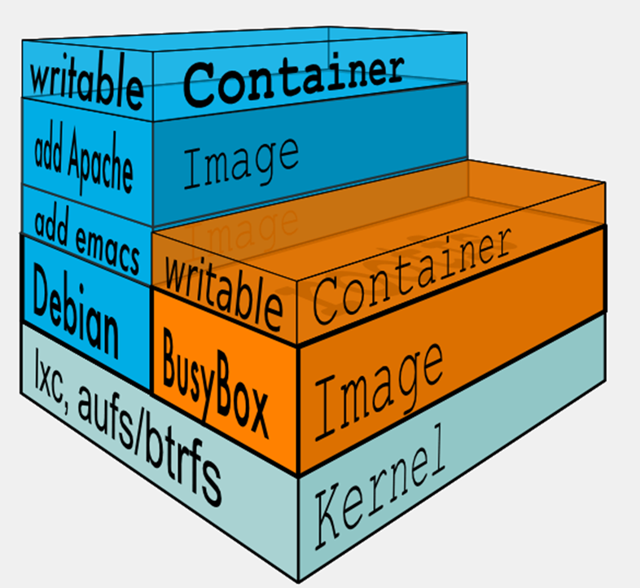
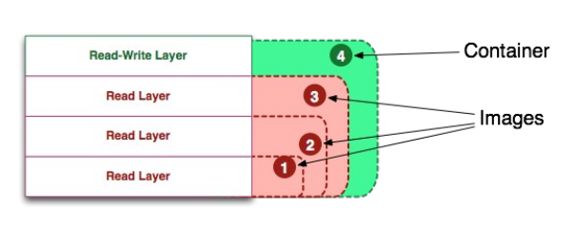
Image vs. Container
Docker Image is a class
Docker Container is a instance of class

Slide 34
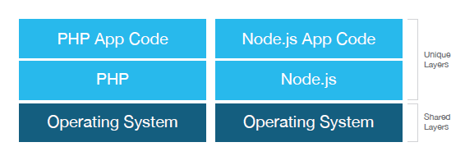
Docker will not only share the base image between containers, but it will also share the same layers between different images.

Slide 35
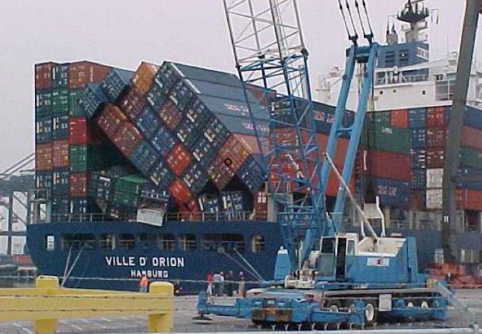
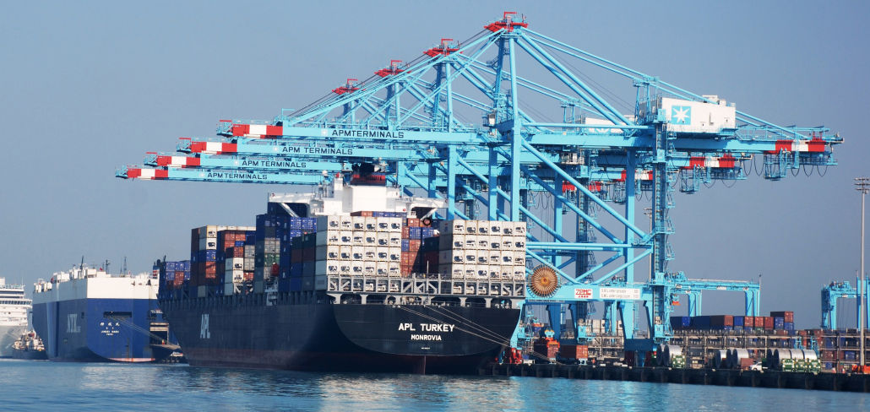
Docker Orchestration
Problems with standalone Docker Running a server cluster on a set of Docker containers, on a single Docker host is vulnerable to single point of failure!

Slide 36
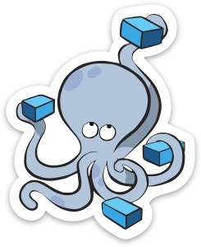
Docker Compose
Tool for defining and running multi-container
applications with Docker in a single file
Fast, isolated development environments using Docker.
Quick and easy to start.

Slide 37
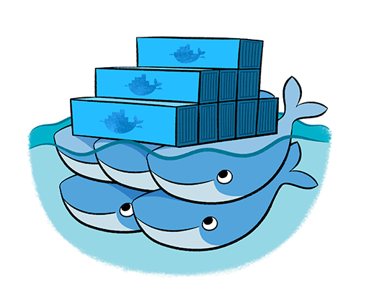
Docker Swarm
Native Clustering System
Clustering (management) for Docker.
Manage multiple Docker daemons.
Distribute workloads.

Slide 38
Docker Architecture

Slide 39
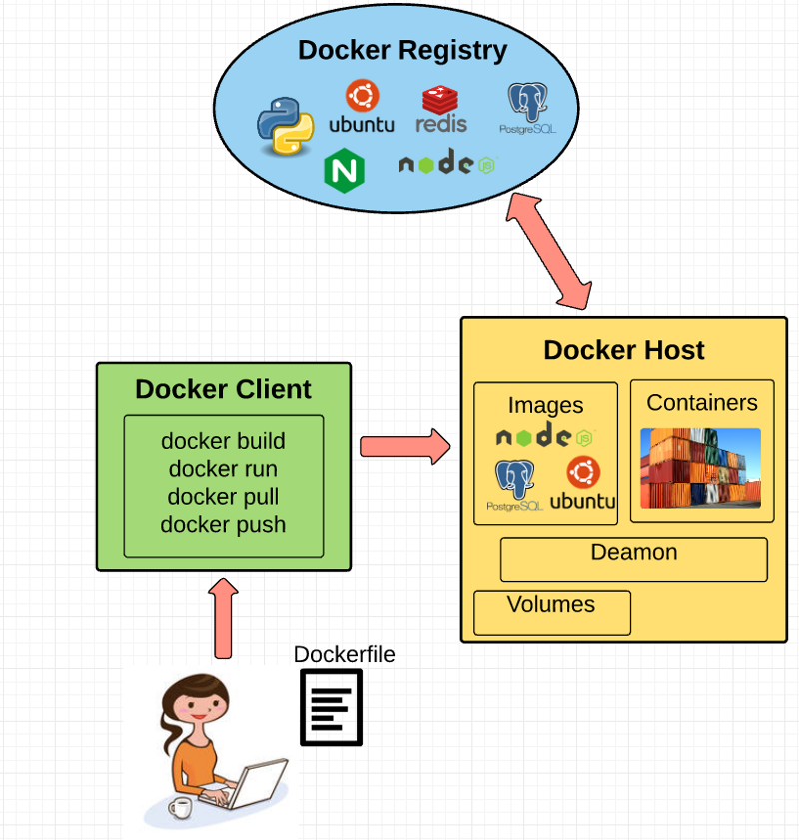
Docker Architecture

Slide 40
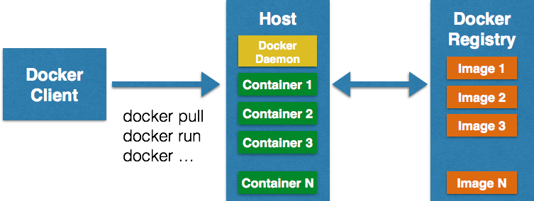
Docker Architecture

Slide 41
Why are Docker containers lightweight?
VMs
Containers
App
A
App
A
App
A’
App
A
App
A
App Δ
Bins/
Libs
Bins/
Libs
Bins/
Libs
Bins/
Libs
Bins/
Guest
OS
Guest
OS
Guest
OS
Guest
OS
Original App
(No OS to take
up space, resources,
or require restart)
Copy of
App
No OS. Can
Share bins/libs
Modified App
Copy on write capabilities allow
us to only save the diffs
Between container A and container
A’
VMs
Every app, every copy of an
app, and every slight modification
of the app requires a new virtual server

Slide 42
What are the basics of the Docker system?
Container A
Docker
Container
Image Registry
Push
Search
Pull
Source Code Repository
Run
Build
Dockerfile
For
A
Container A
Container B
Container C
Docker
Docker Engine
Host 1 OS (Linux)
Host 2 OS (Linux)

Slide 43
Changes and Updates
Docker
Container
Image Registry
App
A
Push
App Δ
Bins/
Libs
Bins/
Base
Container
Image
Container Mod A’
Container Mod A’’
App Δ
Update
App
A
Bins/
App
A’’
Bins/
Libs
Bins/
Libs
Bins/
Docker Engine
Docker Engine
Host is now running A’’
Host running A wants to upgrade to A’’. Requests update. Gets only diffs

Slide 44
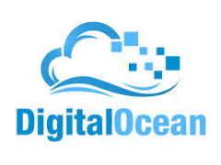
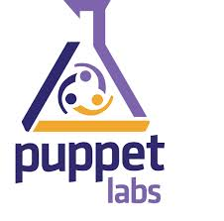
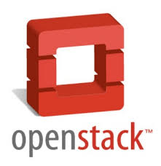
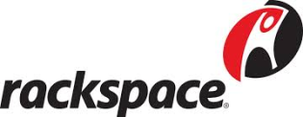





Ecosystem Support
Operating systems
Virtually any distribution with a 2.6.32+ kernel
Red Hat/Docker collaboration to make work across RHEL 6.4+, Fedora, and other members of the family (2.6.32 +)
CoreOS—Small core OS purpose built with Docker
OpenStack
Docker integration into NOVA (& compatibility with Glance, Horizon, etc.) accepted for Havana release
Private PaaS
OpenShift
Solum (Rackspace, OpenStack)
Other TBA
Public PaaS
Deis, Voxoz, Cocaine (Yandex), Baidu PaaS
Public IaaS
Native support in Rackspace, Digital Ocean,+++
AMI (or equivalent) available for AWS & other
DevOps Tools
Integrations with Chef, Puppet, Jenkins, Travis, Salt, Ansible +++
Orchestration tools
Mesos, Heat, ++
Shipyard & others purpose built for Docker
Applications
1000’s of Dockerized applications available at index.docker.io

Slide 45
Use Cases !!

Slide 46
Use Cases
Ted Dziuba on the Use of Docker for Continuous Integration at Ebay Now
https://speakerdeck.com/teddziuba/docker-at-ebay
http://www.youtube.com/watch?feature=player_embedded&v=0Hi0W4gX--4
Sasha Klizhentas on use of Docker at Mailgun/Rackspace
http://www.youtube.com/watch?feature=player_embedded&v=CMC3xdAo9RI
Sebastien Pahl on use of Docker at CloudFlare
http://www.youtube.com/watch?feature=player_embedded&v=-Lj3jt_-3r0
Cambridge HealthCare
http://blog.howareyou.com/post/62157486858/continuous-delivery-with-docker-and-jenkins-part-i
Red Hat Openshift and Docker
https://www.openshift.com/blogs/technical-thoughts-on-openshift-and-docker

Slide 47
Ecosystem

Slide 48
Ecosystem
Use Case | Examples | Link
Clusters | Building a MongoDB cluster using docker | http://bit.ly/1acbjZf
 | Production Quality MongoDB Setup with Docker | http://bit.ly/15CaiHb
 | Wildfly cluster using Docker on Fedora | http://bit.ly/1bClX0O
Build your own PaaS | OpenSource PaaS built on Docker, Chef, and Heroku Buildpacks | http://deis.io
Web Based Environment for Instruction | JiffyLab – web based environment for the instruction, or lightweight use of, Python and UNIX shell | http://bit.ly/12oaj2K
Easy Application Deployment | Deploy Java Apps With Docker = Awesome | http://bit.ly/11BCvvu
 | How to put your development environment on docker | http://bit.ly/1b4XtJ3
 | Running Drupal on Docker | http://bit.ly/15MJS6B
 | Installing Redis on Docker | http://bit.ly/16EWOKh
Create Secure Sandboxes | Docker makes creating secure sandboxes easier than ever | http://bit.ly/13mZGJH
Create your own SaaS | Memcached as a Service | http://bit.ly/11nL8vh
Automated Application Deployment | Multi-cloud Deployment with Docker | http://bit.ly/1bF3CN6
Continuous Integration and Deployment | Next Generation Continuous Integration & Deployment with dotCloud’s Docker and Strider | http://bit.ly/ZwTfoy
 | Testing Salt States Rapidly With Docker | http://bit.ly/1eFBtcm
Lightweight Desktop Virtualization | Docker Desktop: Your Desktop Over SSH Running Inside Of A Docker Container | http://bit.ly/14RYL6x

Slide 49
Thank You For Listening

